Slide 1
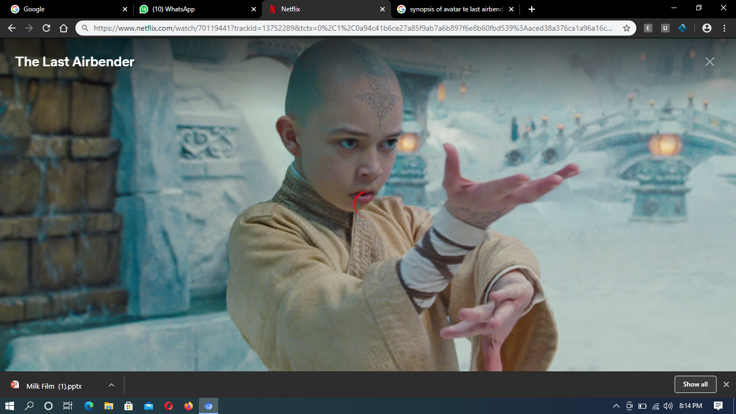

Avatar: The Last Airbender
Zack Tyler Eisen

Slide 2
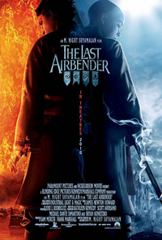
SYNOPSIS
Director: Michael Dante DiMartino
Release Date: 21st February, 2001
Other Popular Work of DiMartino: Atomic Love
Main Actors: Dante Basco, Mae Whitman, Jack De Sena, Zach Tyler Eisen, Bryan Konietzko, Jessie Flower and Dee Bradley Baker

Slide 3

Mise en Scene
Aang with his master during his training stand in front of an array of statues of previous Avatars.
The scene is set with ‘Extremely Long Shot, Scene and Set-Up’. These allow the viewers to see the depth of statues the temple wall and the awe Aang depicts before his previous other forms.

Slide 4
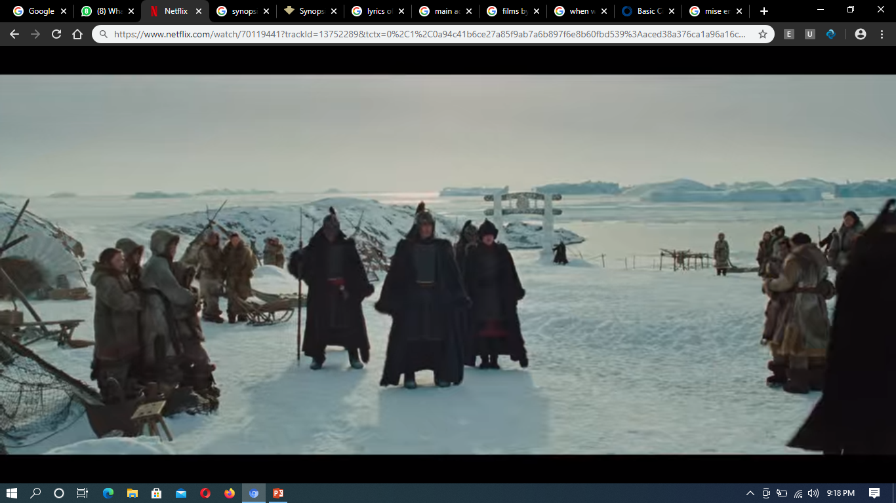
Long Shot
The army of the fire nation raids the water nation in a bid to capture all old men and women.
This shot enables viewers to see what is going on at the moment in a closer look, with the tension that is created in the scene.

Slide 5
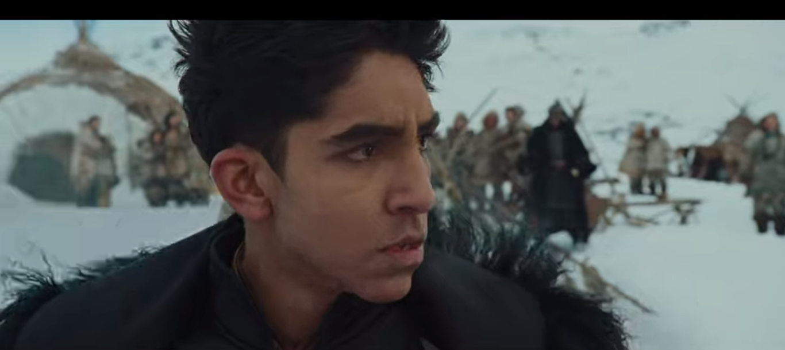
Extremely Close Up Shot
This scene comes in just after the fire nation invades the Northern water benders. He sternly threatens them to save themselves by surrendering the old people.

Slide 6
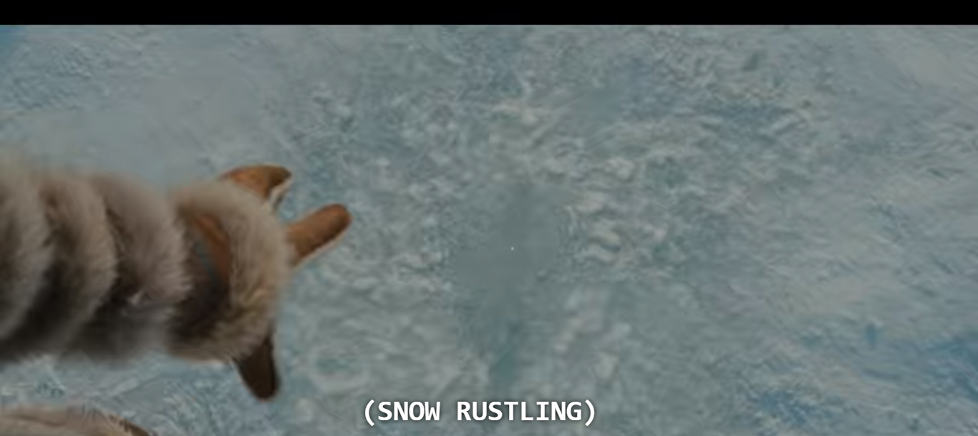
Point-of-View Shot
This scene uses the point of view shot to show Katara use her water bending power as she depicts her hunger over the taking of their grandmother. She swirls the eyes and her brother stops her.

Slide 7
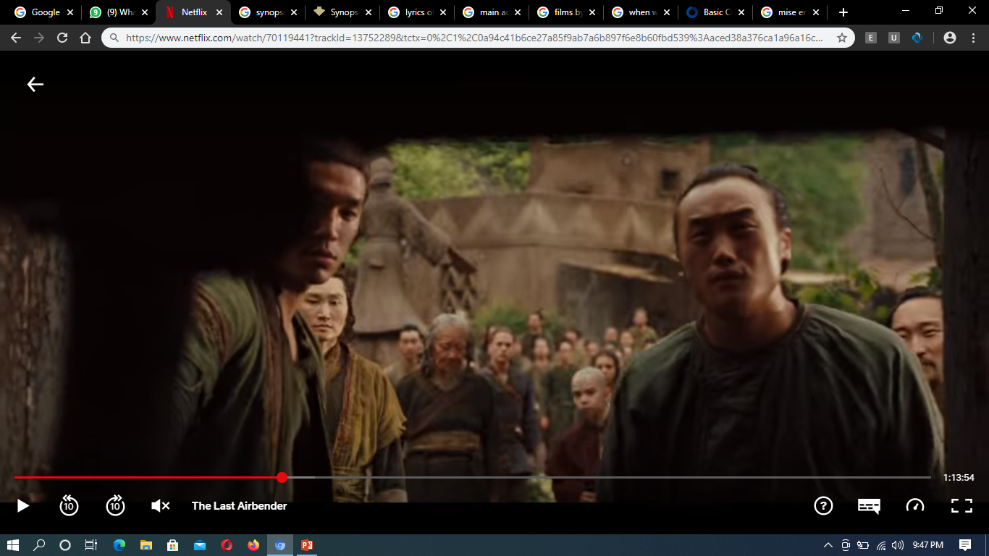
Medium Shot
Medium shot view is use in this scene showing the earth benders gather together to reposes their earth bending tools that were confiscated by the fire nation after their prophesized liberation by the airbender who will be the next Avatar, Aang

Slide 8
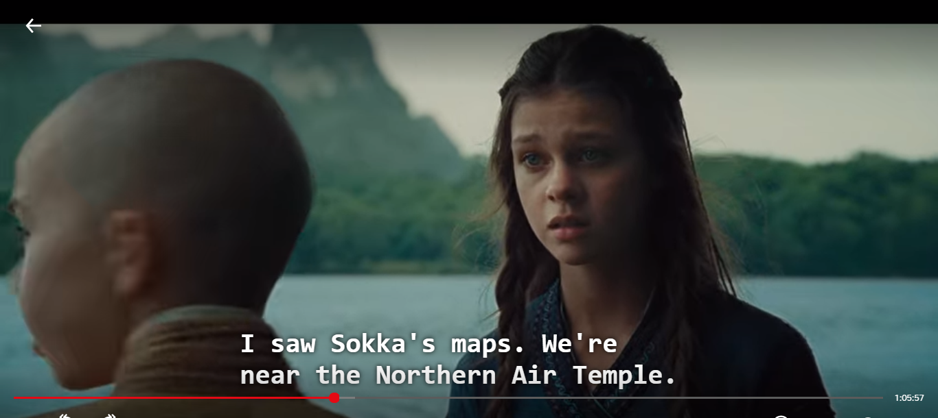
Over-the-Shoulder Shot
Aang and Katara are training, on the river as Aang struggles with his water bending skills which he fears that makes him not to be ready since the Avatar can control all the elements yet he only bends air.

Slide 9
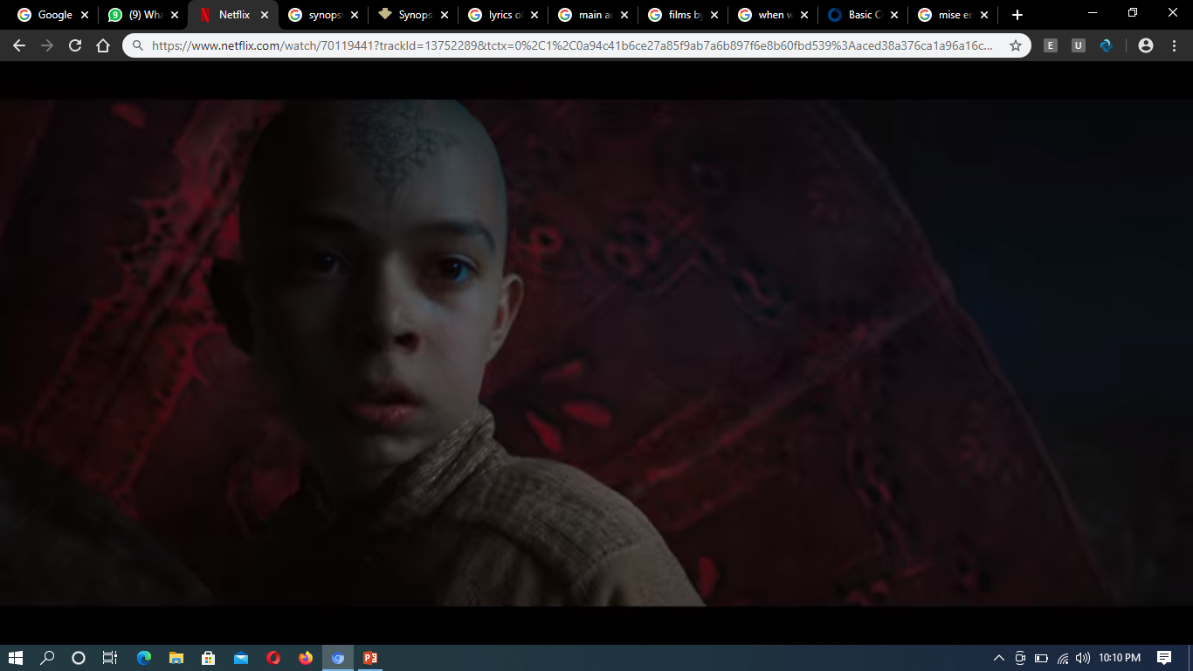
Close Shot
This scene uses the close shot to reveal Aang the Avatar looking back at the Blue Spirit fighting the fire nation armies alone after rescuing him.

Slide 10
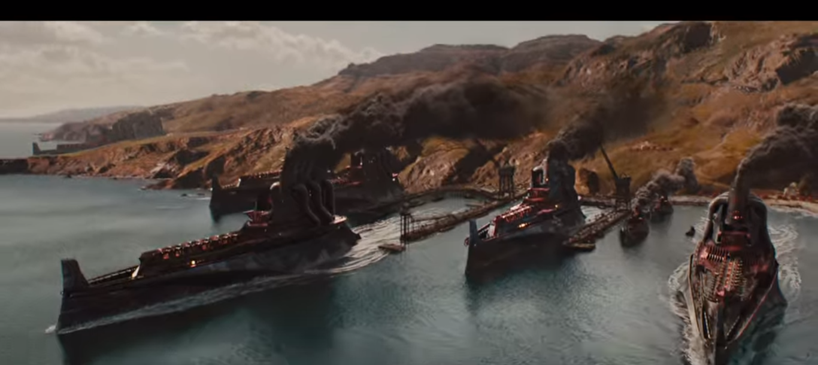
Crane Shot
The fire nation ships draw near to the water nation in a just after Avatar reaches the place to perfect his skills.

Slide 11
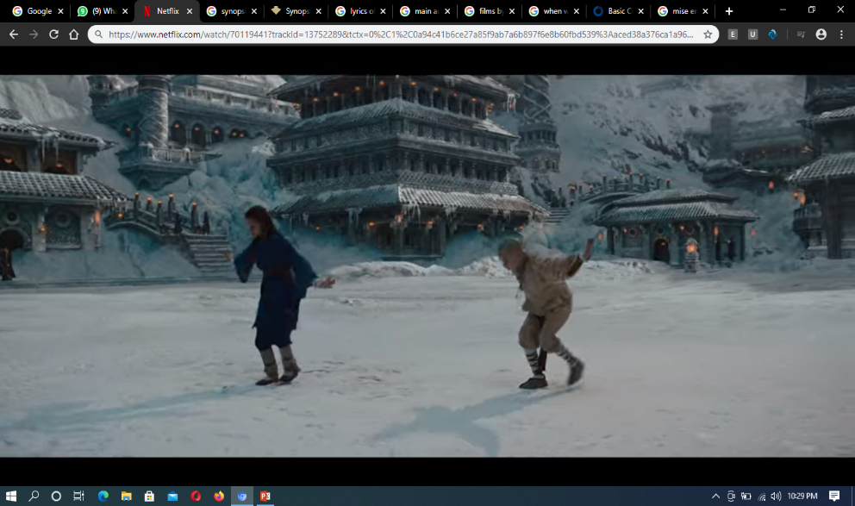
Planning Shot
This planning shot depicts action and a carefully composed final frame involved in the training of Aang and Katara revealing the surrounding environment purely made of ice.

Slide 12
Thank You!

Slide 13
Works Cited
Avatar: The Last Airbender. Directed by Michael D. DiMartino. 2005. Film.
Film Glossary, www.owlnet.rice.edu/~engl377/film.html.
Bibliography
"Access to This Page Has Been Denied." Access to This Page Has Been Denied. Accessed February 23, 2021. https://www.adorama.com/alc/14-basic-cinematography-techniques-for-better-cinematic-shots/.

